Slide 1

Mixtures & Alligations

Slide 2
CP of 1 unit of cheaper Element (C)
CP of 1 unit of dearer Element (d)
CP of 1 unit of mixture (m) or mean
d-m
m-c

Slide 3
In what ratio must rice at Rs. 9.30 per kg be mixed with rice at Rs. 10.80 per kg so that the mixture be worth Rs. 10 per kg ?

Slide 4
In what proportion must rice at Rs. 3.10 per kg be mixed with rice at Rs. 3.60 p/kg so that the mixture be worth Rs. 3.25 per kg ?

Slide 5
The cost of Type 1 rice is Rs. 15 per kg and Type 2 rice is Rs. 20 per kg. If both Type 1 and Type 2 are mixed in the ratio of 2 : 3, then the price per kg of the mixed variety of rice is:

Slide 6
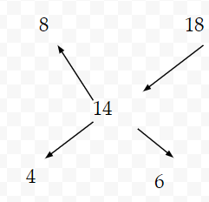
We bought 100 kg rice. Some quantity of them is sold at 8% profit and some is sold at 18% profit. Therefore overall profit is 14%. Find the quantity of rice of both part.

Slide 7
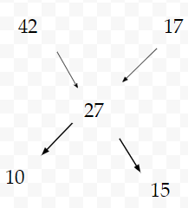
A bottle of whisky contains 42% alcohol. Some part of this bottle is replaced by another bottle of whisky which contains 17% alcohol. Now this mixture contains 27% alcohol. Which part of bottle has been replaced?

Slide 8
A jar full of whisky contains 40% of alcohol. A part of this whisky is replaced by another containing 19% alcohol and now the percentage of alcohol was found to be 26%. The quantity of whisky replaced is—

Slide 9
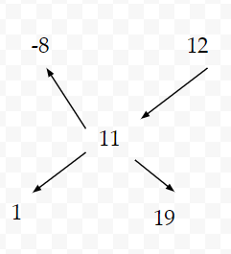
A man has 60 pens. He sells some of these at a profit of 12% and the rest at 8% loss. On the whole, he gets a profit of 11%. How many pens were sold at 12% profit and how many 8% loss ?

Slide 10
A sum of Rs.41 was divided 50 students. If each boy get 90 paisa & each girl get 65 paisa. Find the no.of boys?

Slide 11
There are pigeons and rabbits in a zoo. If heads are counted then there are 90 total and if legs are counted then there are 224 total. Find the number of pigeon and rabbits.

Slide 12
15 litres of a mixture contains 20% alcohol and the rest water.If 3 litres of water be mixed in it,the percentage of alcohol in the new mixture will be—

Slide 13
A sum of Rs. 5000 is lent out in two parts in such a way that the first part at 4% per annum and second part at 5% per annum. If the total interest received after two years is Rs. 440. Find the sum lent at 4% and 5%?

Slide 14
How many kilograms of sugar costing Rs.6.10 per kg.must be mixed with 126 kg. of sugar costing Rs. 2.85 per kg. so that 20% may be gained by selling the mixture at Rs. 4.80per kg.?

Slide 15
How many kgs of Basmati rice costing Rs.42/kg should a shopkeeper mix with 25 kgs of ordinary rice costing Rs.24 per kg so that he makes a profit of 25% on selling the mixture at Rs.40/kg

Slide 16
How many kgs. of wheat costing Rs. 8 per kg must be mixed with 86 kg of rice costing Rs. 5.40 per kg so that 20% gain may be obtained by Selling the mixture at Rs. 7.20 per kg ?

Slide 17
In what ratio must water be mixed with milk to gain 25% on selling the mixture at cost price?

Slide 18
In what ratio must water be mixed with milk to gain 16 2/3% on selling the mixture at cost price?

Slide 19
In what ratio must water be mixed with milk to gain 14 2/7 % on selling the mixture at cost price?

Slide 20
A container contains 80 ltr. of milk. From this container , 8 ltrs. of milk was taken out and replaced by water. This process was further repeated two times. How much milk is now contained by the container?

Slide 21
Three utensils contain equal mixtures of milk and water in the ratio 6 : 1 , 5 : 2 and 3 : 1
respectively. If all the solutions are mixed together, find the ratio of milk and water in the final mixture.

Slide 22
Two vessels A and B contain spirit and water in the ratio 5:2 and 8:5 respectively. Find the ratio in which these mixture be mixed to obtain a new mixture containing spirit and water in the ratio 9:4?

Slide 23
The milk and water in two vessels A and B are in the ratio 4 : 3 and 2: 3 respectively. In what ratio, the liquids in both the vessels be mixed to obtain a new mixture in vessel C containing half milk and half water?

Slide 24
A container contains 40 litres of milk. From this container 4 litres of milk was taken out and replaced by water. This process was repeated further two times. How much milk is now contained by the container?

Slide 25
The ratio of milk and water in a mixture is 3 : 5. We added 10 lt water to the mixture then ratio becomes 3 : 7. Find the initial quantity of milk.
15 lt
12 lt
20 lt
17 lt

Slide 26
The ratio of milk and water in a mixture of 66 lt is 5 : 6. We added 12 lt water to the mixture, then find the ratio of milk and water.
5 : 8
2 : 4
7 : 9
1 : 3

